Slide 1
Request for a Drive Selection Tool for IDS Sales
11th July 2022

Slide 2
Request for a Drive Selection Tool for IDS Sales
Background: Sales Partners and KAMs asked for a Tool for finding the right drive solution for a customer request in an easy and fast way (→ Time to market)
Idea:
Generate a data base of available DC Motors
Create an interface for Motor requirements input
Using the established functions of Drive Simulation

Slide 3
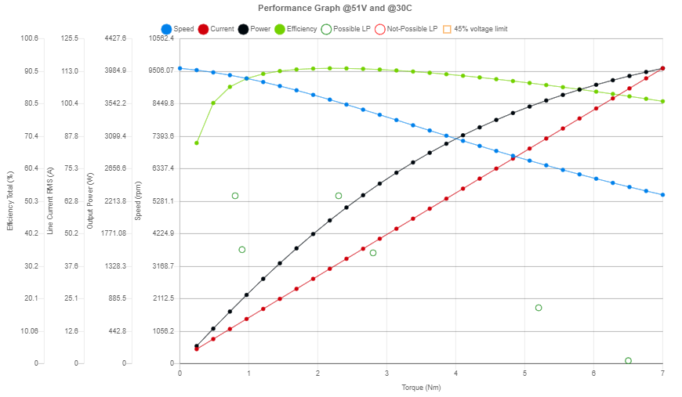
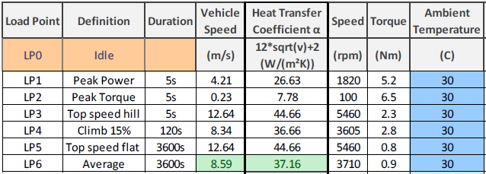
Request for a Drive Selection Tool for IDS Sales
Input from user:
Selection of DC Motor (Step 1)
Required load points
Temperature in application
Supply Voltage
Output from tool:
Selection of DC Motor (Step 2)
Characteristic diagram
Feedback about load points
Example for output:
Example for input:

Slide 4
Vision & Outlook
For Drive Selection (Step 2): Decision criteria for selection (Efficiency, GM, Price)
Possible combinations with Add-ons (Planetary Gear, Worm Gear)
Dialog-guided adaption of the motor (winding, magnets, voltage level)
Further development of the selection tool for bFlowC & bFlowO & BLDC & Direct Drive

Slide 5
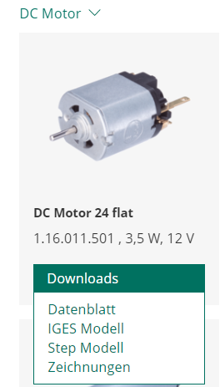
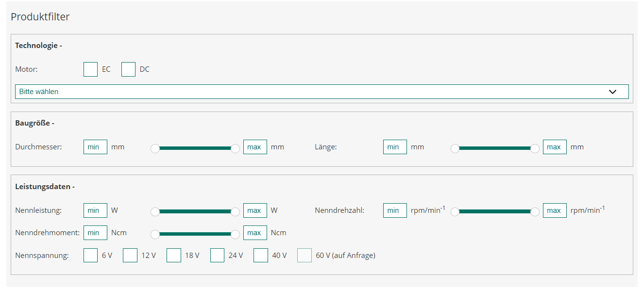
Current solution for Drive selection
User-Input for Product Filter:
Generated Output:
Picture of product
Name & Product number
Other info as pdf download
No performance curve
Points for improvement:
Add specific load points for user input
Points for improvement:
Create Info Page for Products
Integrate data from pdf into web appl.
Include performance curve
Current Product Finder on following link: Standardprodukte (buehlermotor.de)

Slide 6
User management – User and Admin features
User Login and Registration features:
User registration with email
User Login with remember password
Change password.
User profile.
User profile edit & save.
Admin Panel features:
Admin login.
Admin password Chane password.
Admin profile.
Dashboard View
Users list.
Add new user with role.
Edit & save user.
Delete user.

Slide 7
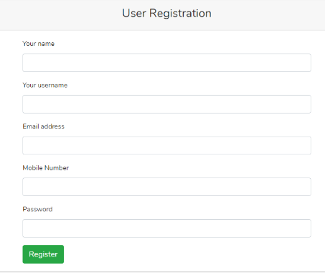
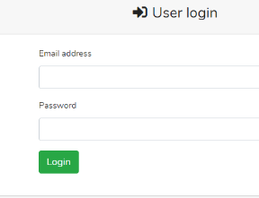
User management – User login & registration
Your company

Slide 8
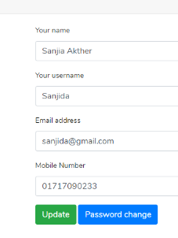
User management – User Profile
Your company

Slide 9
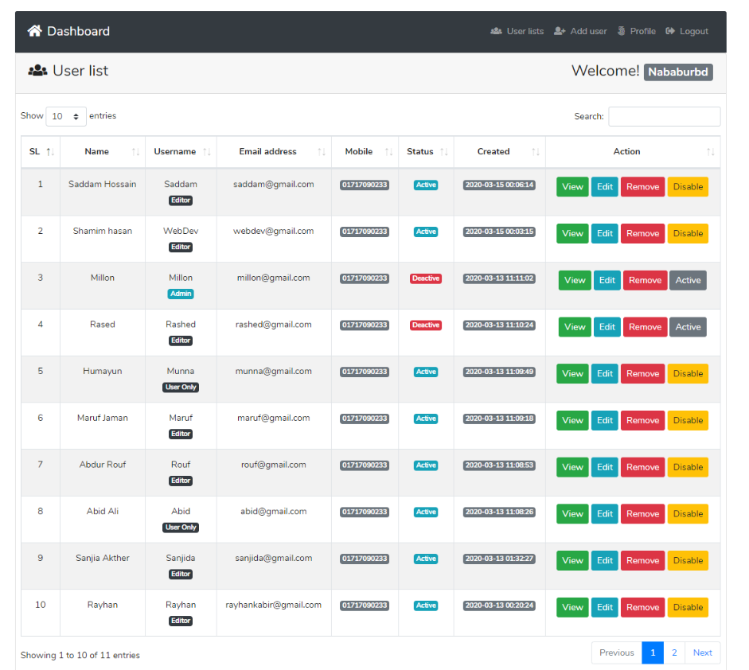
User management – User list & Dashboard
Add to User list:
Company name
Last login
Login counts
User Dashboard for Admin:
- Integrate Google Analytics (nice to have)

Slide 10
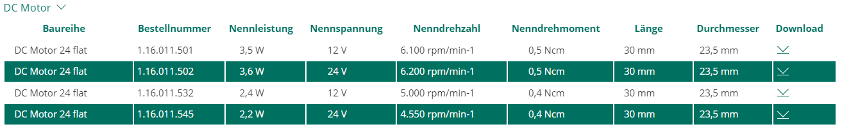
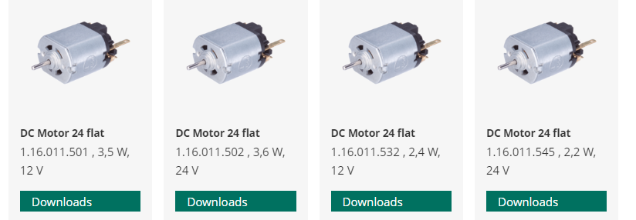
Drive selection tool – General Overview
User Input:
Required load points
Supply voltage
Operating Temperature
Motor choice
Parameter adjustment (Winding, length, voltage)
Tool Output - 2 different views (similar to current solution):
List with recommended products (links to info page)
Overiew with recommended products (links to info page)
User Login or registration
Info page for each recommended product:
Picture of product
Drawing of product
Performance curve with requested load point
Table with technical info

Slide 11
User Input
Required load point(s):
User Input:
Required load points
Supply voltage
Operating Temperature
Speed [rpm]
Torque [Ncm]
Load point 1
DEL
Load point 2
DEL
Load point 3
DEL
ADD
Operating Voltage [V]
Operating Temperature [°C]
GO

Slide 12
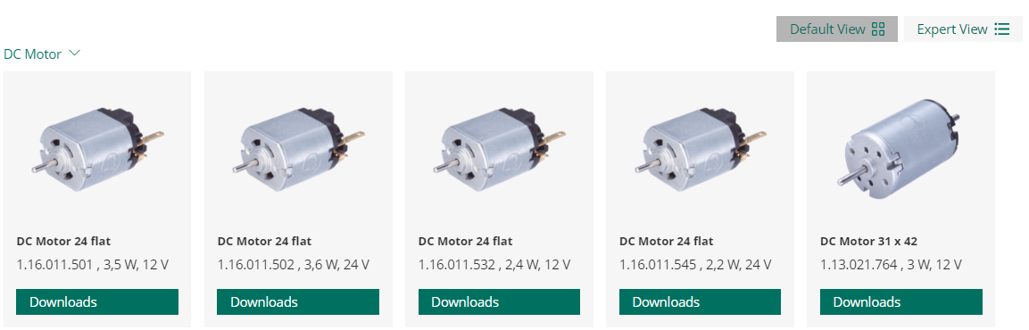
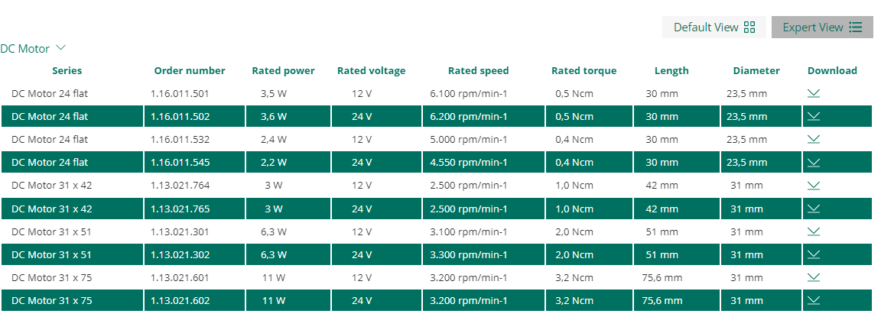
Tool Output - 2 different views (similar to current solution):
Add links to Info page of products (next slide)

Slide 13
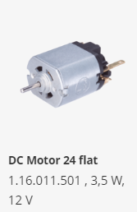
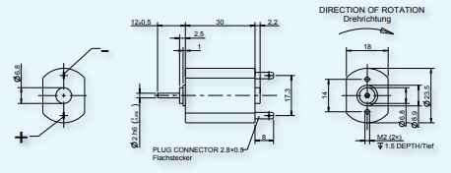
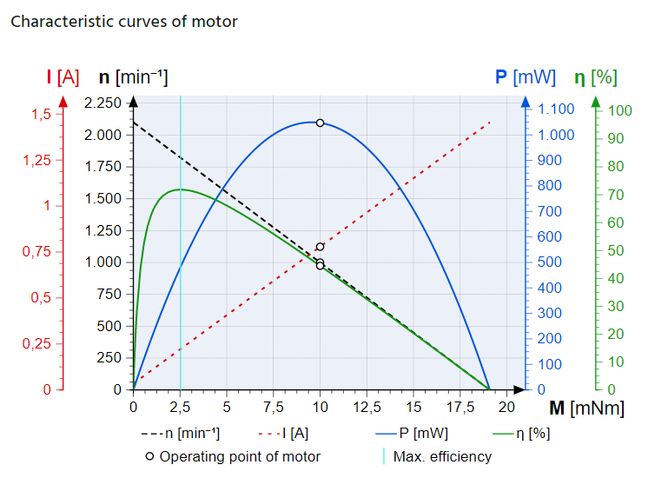
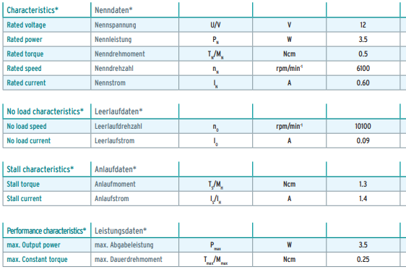
Info page for product
Motor 1
Motor 2
Motor 3
Info page for each recommended product:
Picture of product
Drawing of product
Performance curve with requested load point
Table with technical info

